Slide 1
FEBRUARY 2025

Slide 2
Since 2000, Louisiana has had among the lowest job growth rates in the nation at 2 percent. On top of this, Louisiana has experienced some of the harshest impacts from an increasing number of extreme weather events. But Louisiana has the opportunity to build up the state’s resiliency against extreme weather events, preserve our culture and grow our economy, if we carefully deploy federal and state funds and taxpayer dollars. This report provides 24 one-pagers with easily accessible data that decisionmakers can use to gain consensus and set location-specific priorities, creating opportunities to secure our competitiveness on the national and global stage.

Slide 3
The main reason Americans move long distances is for economic opportunity, and since 2000, Louisiana has had among the lowest job growth rates in the nation at 2 percent.
Job growth and decline, by state
2000 compared to 2024 (annual averages)
65%
50%
25%
U.S., 20%
2%
0%
-4%
UT ID NV TX AZ FL MT ND CO WA SC NC GA SD CA WY OR TN VA AK NM OK DC AR NE DE HI NH NY AL MN KY MD MA MO NJ IN ME KS PA IA WI RI VT MS WV LA IL OH CT MI
Source: Bureau of Labor Statistics. Note: 2024 data is averaged for January 2024–November 2024.

Slide 5
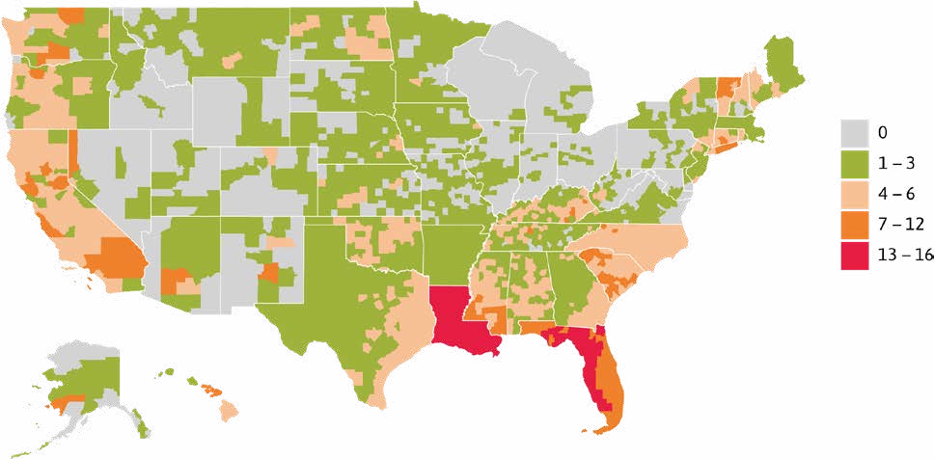
Every Louisiana parish has experienced at least 13 FEMA disaster declarations since 2020 — four times more than the national average. All total, Louisiana has had over 900 disaster declarations since 2020.
Number of FEMA disaster declarations by parish/county
Jan 1, 2020 – November 13, 2024
Source: FEMA.
Notes: Includes all county-level disaster declarations (except COVID-19). For example: Dam/levee breaks, droughts, earthquakes, fires, floods, hurricanes, landslides, severe storms, tornadoes, and water crises.

Slide 6
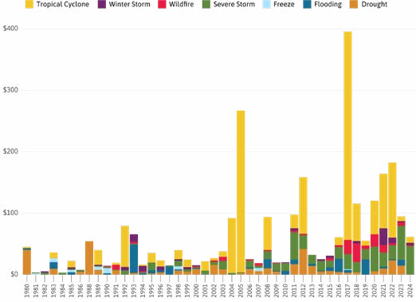
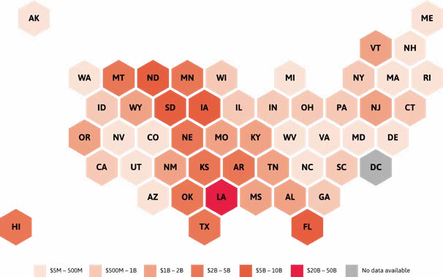
Billion-dollar weather disasters in the U.S. are increasing in size and impact. Since 2020, Louisiana has experienced by far the most damages with at least $20 billion per million residents.
Billion-dollar weather and climate disaster events, U.S. (inflation-adjusted)
Annual cost by type of disaster, 1980–2024 Cost per million residents, 2020–24
Source: NOAA.
Notes: Adjusted for inflation using the Consumer Price Index (CPI). Due to an inherent delay in the accounting of damages, the 2024 number will increase in subsequent updates. Data includes events with less than $1 billion in damage at the time of the event, but which exceed $1 billion in damages after adjusting for inflation. These billion-dollar events account for >80 percent of the damage from all U.S. weather and climate events. No state had between $10B and $20B in damages per million from 2020–2024.

Slide 7
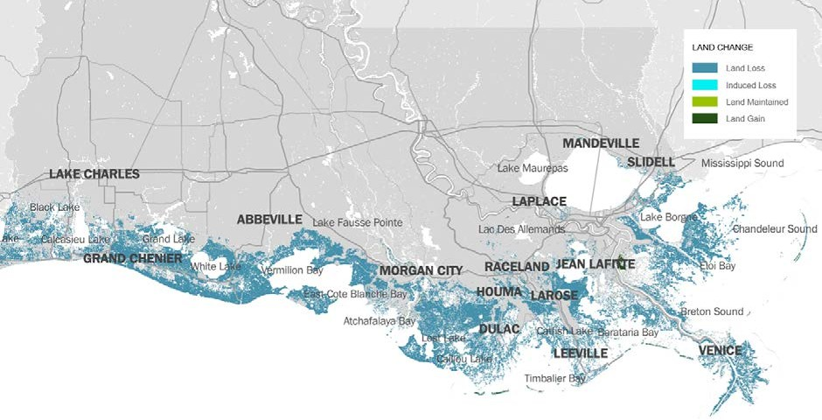
Between 1,100 and 3,000 additional square miles of coastal Louisiana will be lost over the next 50 years without extensive protection and restoration efforts.
Projected coastal land mass change, Louisiana
At year 50, higher environmental scenario, without action
Source: 2023 Louisiana Coastal Master Plan.
Notes: In this higher environmental scenario, Louisiana would experience sea level rise of up to 2.5 ft over the next 50 years. Without action = without projects in the “2023 Coastal Master Plan”.

Slide 8
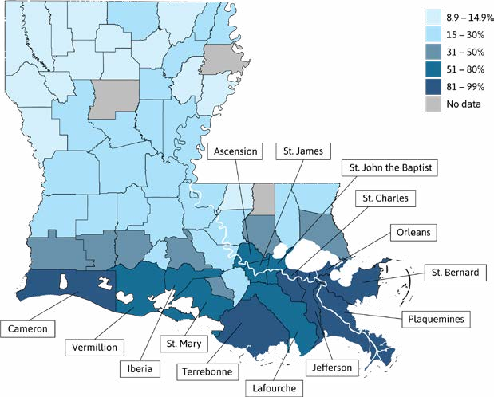
In Louisiana’s southern parishes, more than half of all properties are at major or extreme risk of flooding within the next 30 years.
Share of properties at major to extreme risk for flooding, by Louisiana parish
Based on 30-year cumulative flood likelihood and projected depth of flooding
Source: First Street Foundation-Flood Model (FSF-FM).
Notes: Properties at “major” to “extreme” risk of flooding have at least an 80 percent cumulative probability of being flooded within 30 years (at least a 5 percent chance in any given year). The FSF-FM incorporates flood protection measures (e.g. levees, flood walls, retention ponds, marsh/wetland restoration), multiple types of flooding risks (e.g. tides, rain, riverine and storm surges), as well as future environmental considerations.

Slide 9
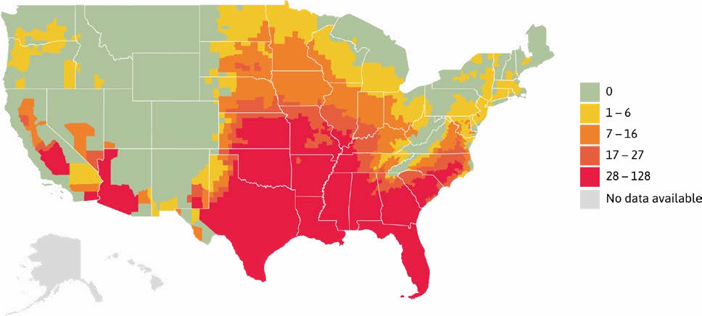
The number of extreme heat days are increasing nationwide. The average number of extreme heat days in Louisiana parishes climbed from 47 in 2021 to 82 in 2023.
Number of extreme heat days (100°F Heat Index) by parish/county
May 2023 – September 2023
Source: CDC/NASA.
Notes: Data not available for Hawaii or Alaska.

Slide 10
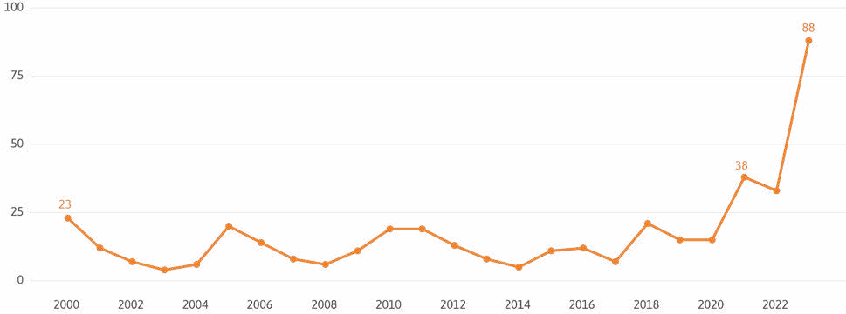
Heat-related deaths in Louisiana have skyrocketed since 2020 – from an annual average of 12 over the previous two decades to an annual average of 44 since 2020.
Heat-related deaths, Louisiana
2000–2023
Source: CDC Wonder.
Notes: Includes deaths for which heat was listed as either the underlying or contributing cause of death. Deaths are identified using ICD–10 underlying/contributing cause-of-death codes: P81.0, T67, and X30.

Slide 12
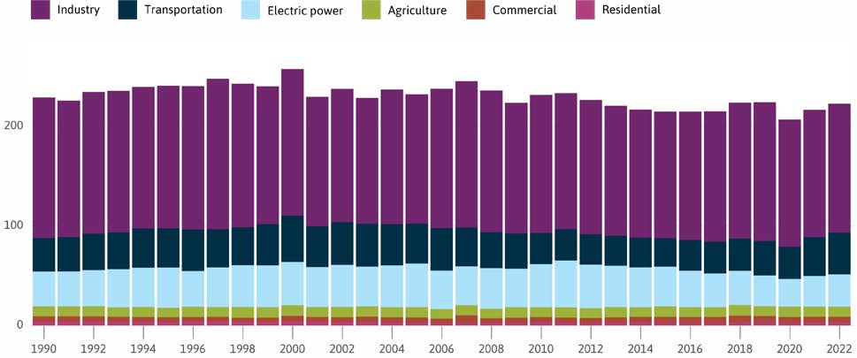
From 1990 to 2022, industry accounted for nearly 60 percent of all emissions in Louisiana.
Louisiana greenhouse gas emissions by economic sector
Emissions in million metric tons of carbon dioxide equivalent
Source: U.S. EPA.
Notes: Types of gases include carbon dioxide, methane, nitrous oxide, hydrofluorocarbons, perfluorocarbons, sulfur hexafluoride, and nitrogen trifluoride.

Slide 13
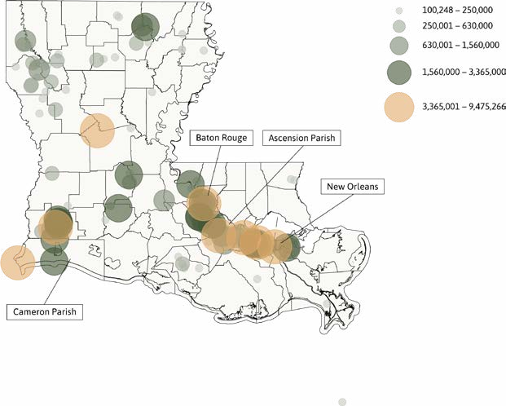
Large facilities in Louisiana’s River Parishes produced 38 million metric tons of greenhouse gases in 2023.
Greenhouse gas emissions from large facilities in Louisiana, 2023
Emissions in metric tons of carbon dioxide equivalent
Source: U.S. EPA.
Notes: : Types of gases include carbon dioxide, methane, nitrous oxide, hydrofluorocarbons, perfluorocarbons, sulfur hexafluoride, and nitrogen trifluoride.

Slide 14
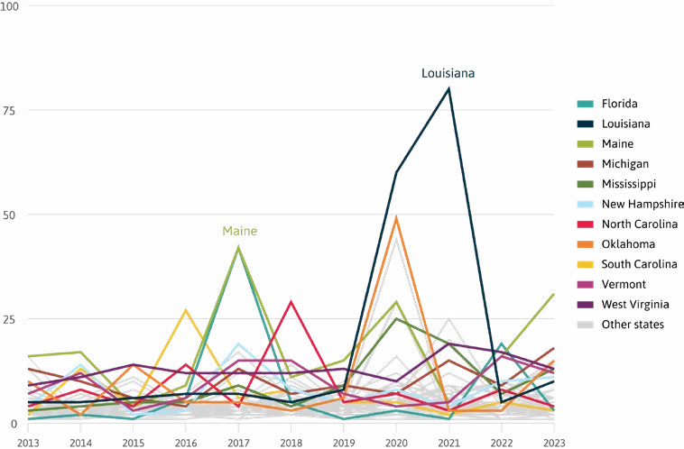
Since 2013, Louisiana has experienced 198 hours of power interruption — the most of any state — three times more than the national average.
Average annual duration of electric power interruptions, by state
Hours per customer
Source: U.S. Energy Information Administration.
Notes: : “Momentary” interruptions that last five minutes or less are generally omitted. Data reported by utilities using IEEE standard as well as any other method.

Slide 15
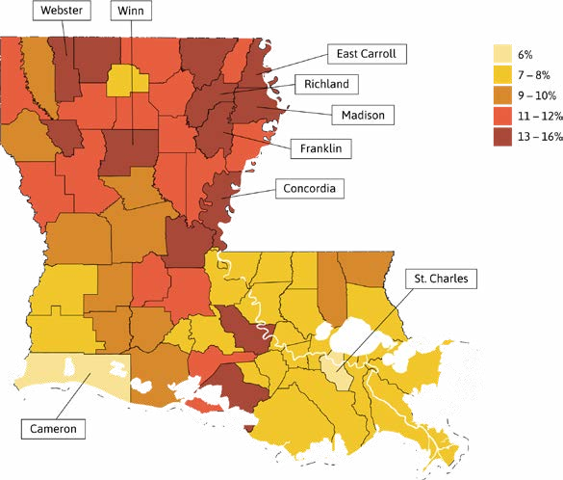
Low-income Louisianans pay a disproportionate share of their income on home energy — 9 percent compared to 6 percent nationally.
Home energy burdens among low-income households, by Louisiana parish
Average percent of income spent on home energy costs, 2018–22 (5-year average)
Source: U.S. Department of Energy.
Notes: “Energy burden” is defined as the percentage of gross household income spent on home energy costs. “Low- income household” is defined as below 80 percent of the area median income, as defined by the U.S. Department of Housing and Urban Development.

Slide 16
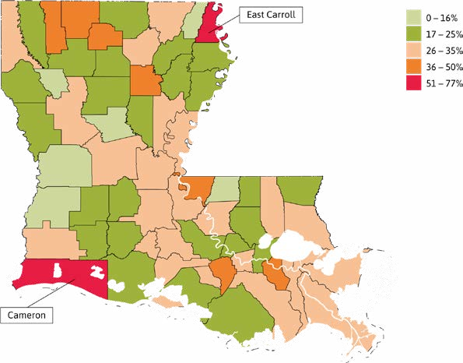
Nearly 1 in 3 Louisianans who rent spend the majority of their income on housing.
Severe housing cost burdens by Louisiana parish, 2019–23 (5-year average)
Percent of renter households paying half or more of household income on housing costs
Source: Census Bureau’s American Community Survey 2019-23.

Slide 17
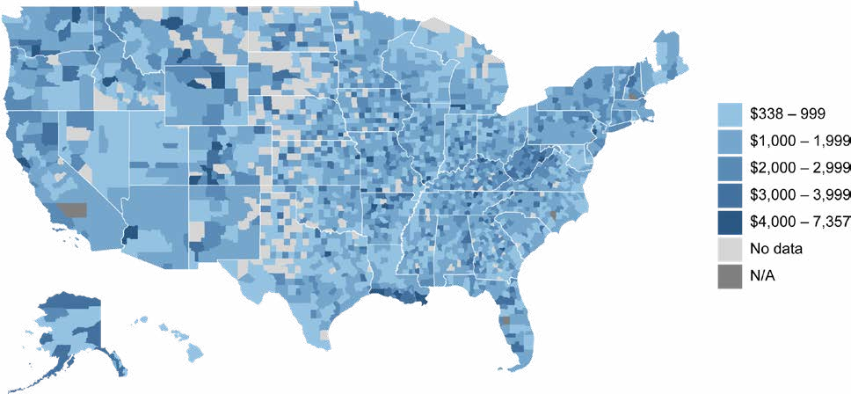
Once full-risk prices are completely implemented, the median cost of flood insurance is projected to increase by 87 percent in Louisiana compared to 64 percent across the U.S.
Median annual cost of full-risk flood insurance (Risk Rating 2.0) by parish/county
Single-family home policyholders in the National Flood Insurance Program
Source: FEMA.
Notes: The full-risk cost of insurance is what policyholders will pay at their full actuarial rate under National Flood Insurance Program’s pricing approach (Risk Rating 2.0). Cost of insurance is defined as all premiums, fees, assessments and surcharges for a policy.

Slide 18
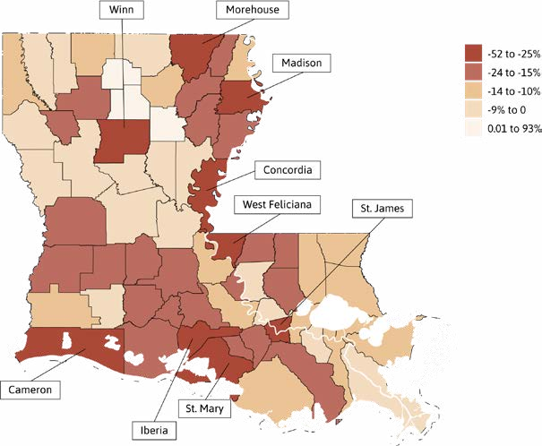
From 2021 to 2024, the number of flood insurance policies across the state shrank by 12 percent.
Percent change in number of flood insurance policies in-force, by Louisiana parish
2021–2024
Source: FEMA/NFIP.
Note: Includes all residential and commercial NFIP policies in-force as of May 2021 and Oct 2024.

Slide 19
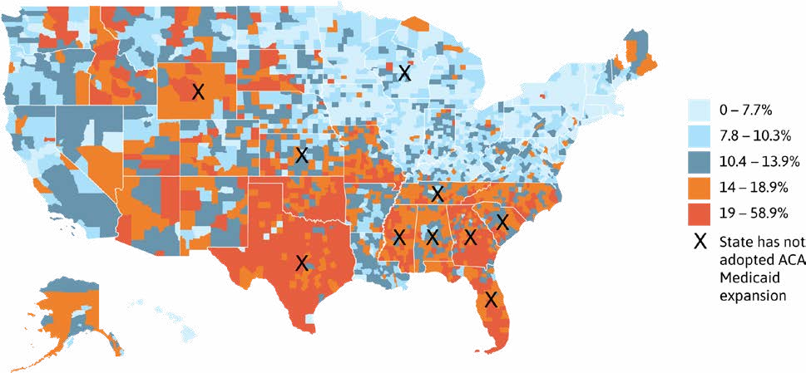
In Louisiana, about 12 percent of working-age adults lack health insurance, which is on par with the national average.
Lack of health insurance coverage by parish/county, 2019–23 (5-yr average)
Percent of population age 19–64
Source: Census Bureau’s American Community Survey 2019–23 and Kaiser Family Foundation.
Notes: North Carolina has high uninsured rates because Affordable Care Act (ACA) Medicaid expansion started Dec. 1, 2023. Wisconsin has relatively low uninsured rates (despite not adopting ACA Medicaid expansion) because Wisconsin has partially expanded Medicaid, under a Medicaid waiver, to include all adults under 100 percent federal poverty level.[^{lviii} 1]

Slide 20
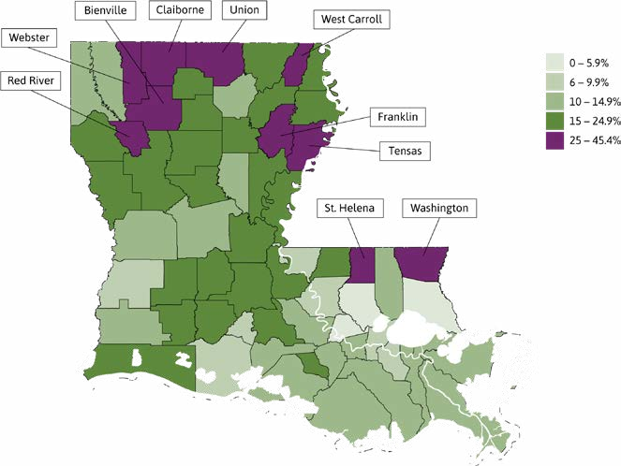
Over 220,000 Louisiana households have no internet — not even a cellular data plan. A disproportionate share (19 percent) of these homes are in rural parishes.
Lack of internet access by Louisiana parish, 2019–23 (5-year average)
Percent of households without internet access
Source: Census Bureau’s American Community Survey 2019–23.
Note: “Lacking internet access” means the household has no internet subscription, no cellular data plan, and no access to the internet without a subscription (such as through property-wide Wi-Fi service in an apartment building).

Slide 21
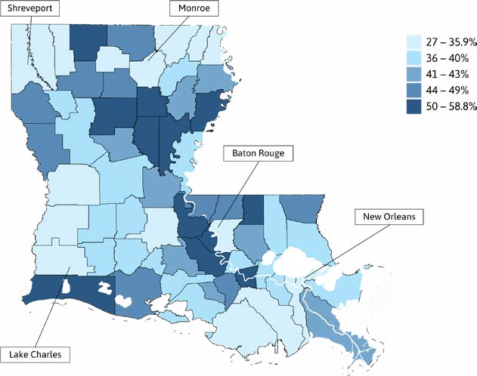
Louisiana’s 2023 election saw the lowest voter turnout in a decade. In more than 80 percent of parishes, fewer than half of registered voters participated.
Voter turnout, by Louisiana parish
Percent of registered voters that participated in the October 2023 primary
Source: Louisiana Secretary of State.

Slide 22
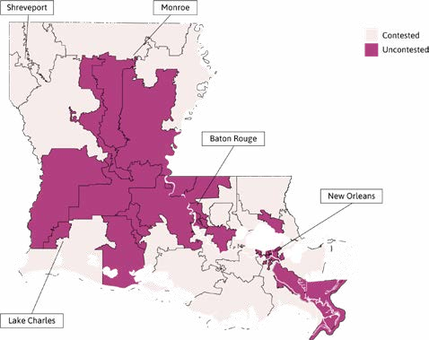
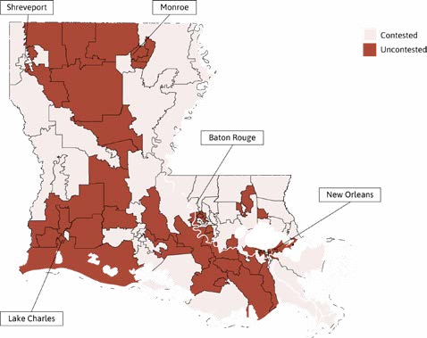
In the 2023 election, 46 percent of Louisiana’s state legislature seats had only one candidate.
Uncontested state legislature seats, Louisiana, 2023
Senate
House
Source: Louisiana Secretary of State.
Notes: Under Louisiana’s majority-vote system all candidates running for a state legislative office appear on the same ballot in the primary, regardless of their partisan affiliations, and can win the election outright by winning a simple majority of all votes cast in the primary. For this reason, a seat was considered “uncontested” if only a single candidate ran for the seat in the primary.

Slide 24
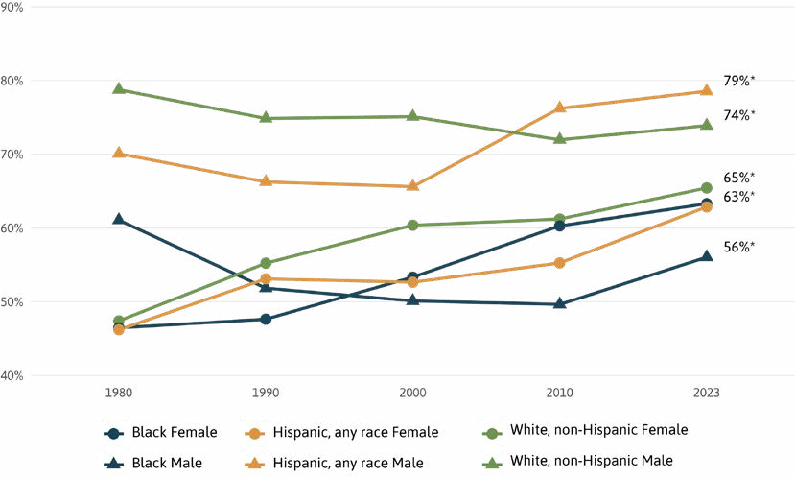
In 2023, 74 percent of working-age White men in Louisiana had employment — down from 79 percent in 1980. And only 56 percent of Black men in Louisiana had employment in 2023 — down from 61 percent in 1980.
Employment rate, by race/ethnicity and gender
For the population 16–64 years old, Louisiana
Source: U.S. Census Bureau and IPUMS NHGIS.
Notes: * = Change overtime is not significant for Hispanic males for 2010–2023. Change over time is not significant for Black males, Hispanic females, and White females for 2000–2010.

Slide 25
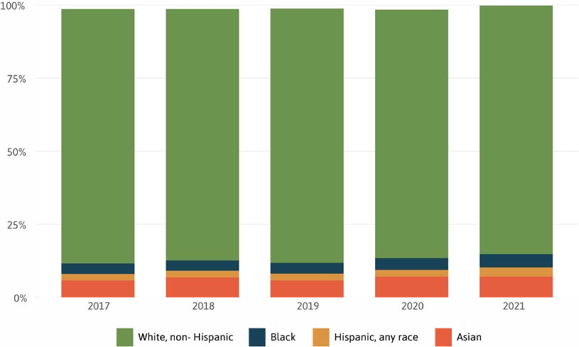
The share of Louisiana’s employer firms that are minority-owned nudged upward from 11.9 percent in 2017 to 15.2 percent in 2021, but remains low relative to their share of the total population (41 percent).
Share of employer firms, by race/ethnicity of owner
Louisiana
Source: Annual Business Survey.
Notes: Race/ethnicity is determined by the majority business owner. Calculations based on number of firms that are classifiable by ethnicity.

Slide 26
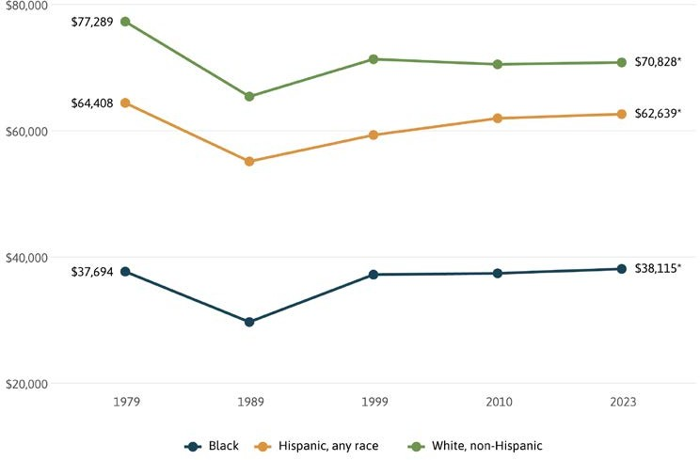
Hispanic incomes are 12 percent lower and Black incomes are 46 percent lower than White incomes in Louisiana.
Median household income by race/ethnicity in 2023 dollars
Louisiana
Source: U.S. Census Bureau and IPUMS NHGIS.
Notes: * = Change in time is not significant for any race 1999–2023.

Slide 27
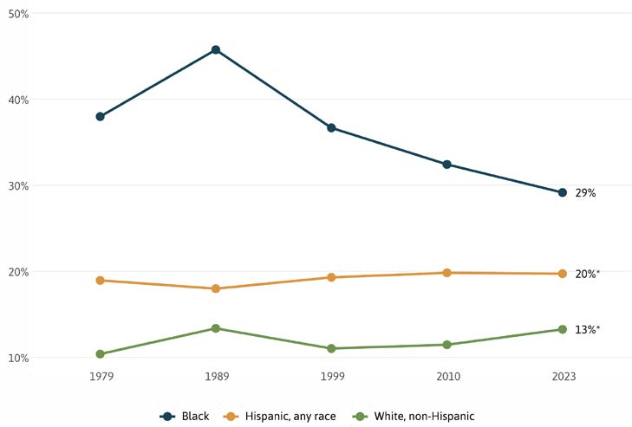
Poverty rates for White and Hispanic Louisianans have remained relatively constant at 13 percent and 20 percent respectively. But for Black Louisianans poverty spiked to 46 percent in the 1980s and fell to 29 percent by 2023.
Poverty rate by race/ethnicity since 1979
Louisiana
Source: U.S. Census Bureau and IPUMS NHGIS.
Notes: * = Change in time is not significant for Hispanic for 1999–2023. Change in time is not significant for White for 1999–2010.

Slide 28
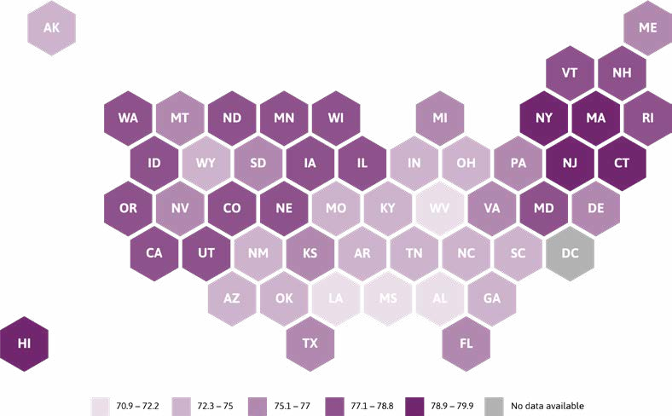
At 72.2 years, Louisiana has among the lowest life expectancy rates of all states. Only in Alabama, West Virginia, and Mississippi is life expectancy lower at 72, 71, and 70.9 years respectively.
Life expectancy at birth
2022
Source: CDC.
Notes: Life expectancy at birth is the average number of years that a newborn would live if death patterns of the population at the time of their birth did not change during their lifetime. This means that any future changes to mortality rates would not be taken into account. Estimates for 2022 are provisional.

Slide 29
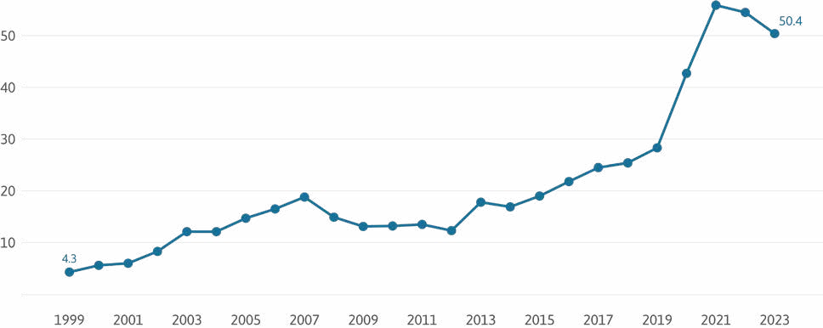
Drug overdose deaths, which are more likely in the face of extreme heat and other natural disasters, exploded from 188 in 1999 to 2,463 in 2021, before decreasing slightly to 2,224 by 2023.
Drug overdose deaths, Louisiana
Rates per 100,000 population, 1999–2023
Source: CDC Wonder.
Notes: 2023 is provisional. Drug overdose deaths are identified using ICD–10 underlying cause-of-death codes: X40–X44, X60–X64, X85, and Y10–Y14. Rates are age-adjusted.

Slide 30
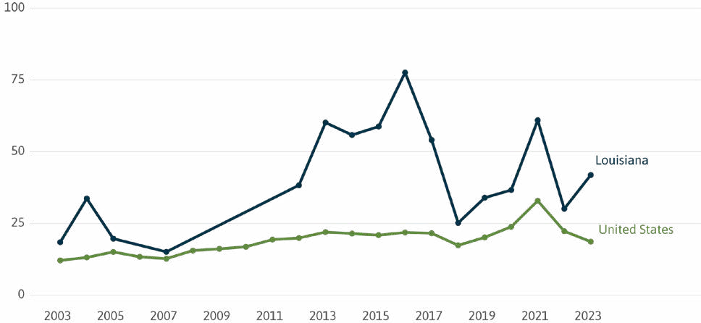
In 2023, Louisiana had 42 pregnancy-related deaths per 100,000 live births — more than twice as high as the national rate of 19.
Pregnancy-related deaths per 100,000 live births
2003–2023
Source: CDC Wonder Mortality Data (deaths) and CDC Wonder Natality Data (births).
Notes: 2023 data is provisional (p). A pregnancy-related death is defined as a death while pregnant or within 42 days of termination of pregnancy, from any cause related to or aggravated by the pregnancy or its management, but not from accidental or incidental causes. Pregnancy-related deaths are identified using ICD–10 underlying cause-of-death codes: A34, O00–O95, and O98–O99.

Slide 31
Learn more about Pathways to Prosperity: Louisiana online at:
www.datacenterresearch.org www.ncoc.org www.p2pclimate.org/louisiana-feb-2025

